Slide 1
Export Controls Workshop
Prepared for NCMA
Zack Hadzismajlovic
zh@mccarter.com

Slide 2
Export Controls-Purpose and Scope
…lest we forget
National Security
  Controlling the export of items/technology that could make a significant contribution to the military might of another country to the detriment of our security.
Foreign Policy
  Exporting items/technology to foster/implement the our foreign policy interests.
Domestic Short Supply
  Protect economy against drain of scarce materials.

Slide 3
What is controlled? Why? By Whom?
The export, temporary import, re-export, or retransfer of defense articles, related technical data and defense services is subject to the International Traffic in Arms Regulations (“ITAR”), administered by the U.S. Department of State, Directorate of Defense Trade Controls (“DDTC”).
The export of items irrespective of origin or the re-export of U.S.-origin items or technologies that are commercial or “dual-use” in nature is subject to the Export Administration Regulations (“EAR”), administered by the U.S. Department of Commerce, Bureau of Industry and Security (“BIS”).
Items, services regardless of jurisdiction if destined for countries/entities/individuals subject to embargoes and sanctions are administered by the Department of Treasury’s, Office of Foreign Assets Control (OFAC).

Slide 4
U.S. Jurisdiction
The United States export controls laws and regulations assert jurisdiction based upon the nationality of the entity/person, the location of the entity/person, and origin of the goods:
  U.S. persons
  U.S. territory
  U.S. origin
What does that mean?

Slide 5
U.S. Jurisdiction-Extraterritoriality
The jurisdiction “follows the part” and is derived from the “U.S. nationality” of the item or service exported from the United States and applies to all of the following, with some exceptions:
  Items in the United States, regardless of origin
  All items of U.S. origin, wherever located
  Foreign-made items that incorporate more than de minimis amounts of controlled U.S. content (parts, components, materials, subassemblies, etc.)
  Foreign-made items that are the direct product of certain U.S. origin technology or software

Slide 6
U.S. Jurisdiction-Extraterritoriality
Jurisdiction is based on the nationality of the controlled goods and technology as well as the nationality of the person receiving or exporting them.
A U.S. person, wherever located, will be subject to U.S. export laws and regulations whether dealing with U.S. or foreign origin goods.
U.S. export controls “follow the part,” therefore, non U.S. persons subject to U.S. export controls when exporting goods or technology from the United States or when dealing with U.S. origin controlled goods and technology, inside or outside the U.S., because the goods or technology retain their “U.S. nationality”.

Slide 7
ECR: Still ITAR
Category I – Firearms, Close Assault Weapons and Combat Shotguns
Category II Guns and Armament
Category III – Ammunition/Ordnance

Slide 8
ECR: ITAR EAR
Certain items and “specially designed” parts and components of Cat. IV, V, VI, VII, VIII, IX, X, XI, XII, XIII, XIV, XV, XVI, XVIII, XIX and XX
Fire Control/Sensors/Night Vision transition end date: 12/30/2018
Toxicological Agents transition end date:
12/30/2018
Directed Energy Weapons transition end date:
12/30/2018

Slide 9
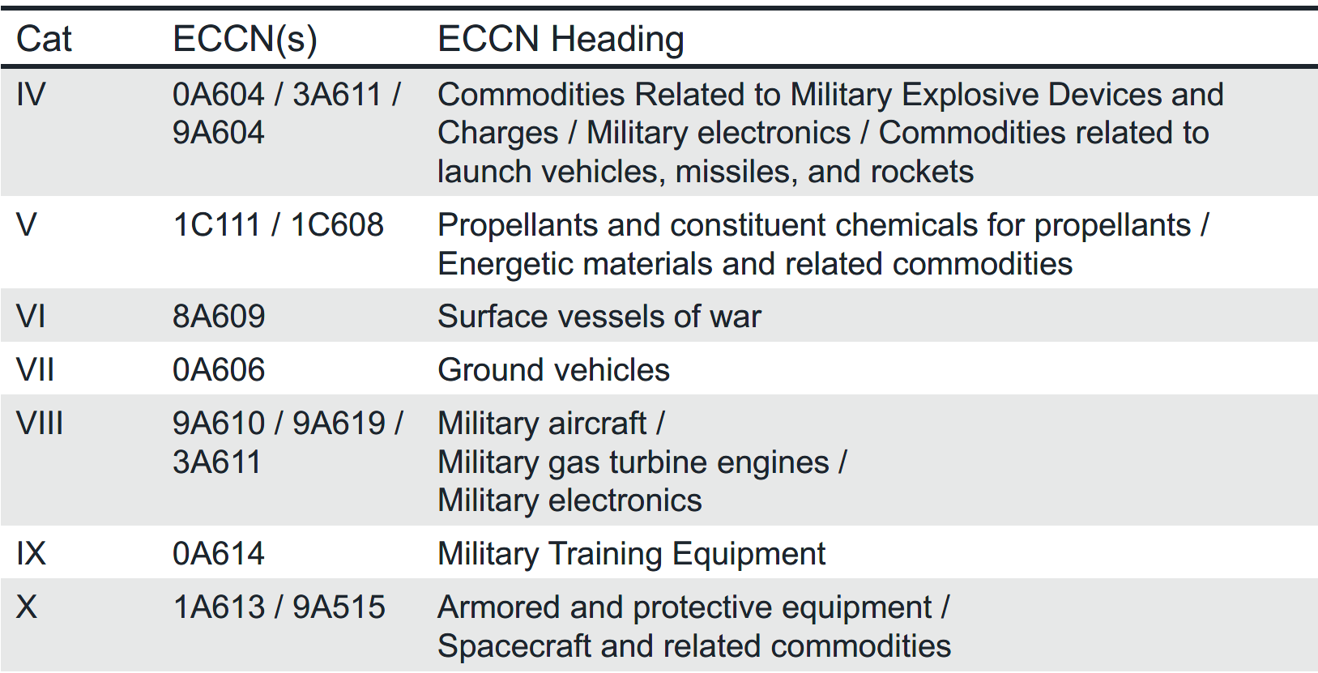
ECR: ITAR EAR

Slide 10
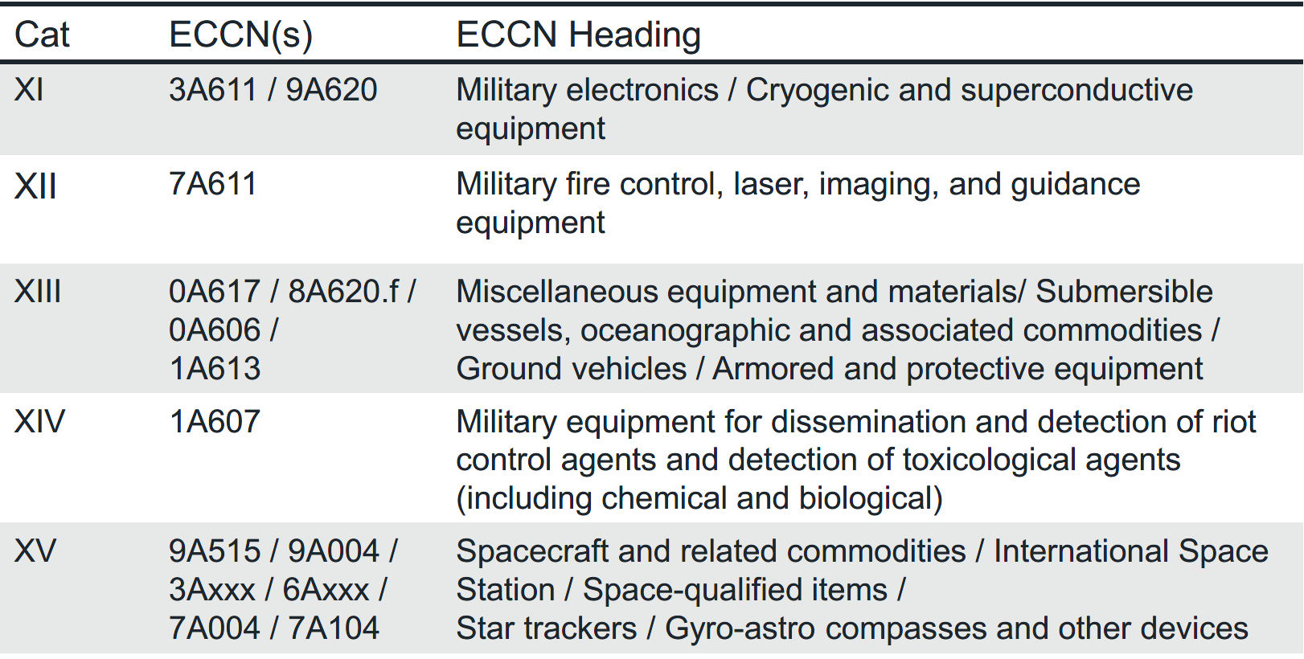
ECR: ITAR EAR

Slide 11
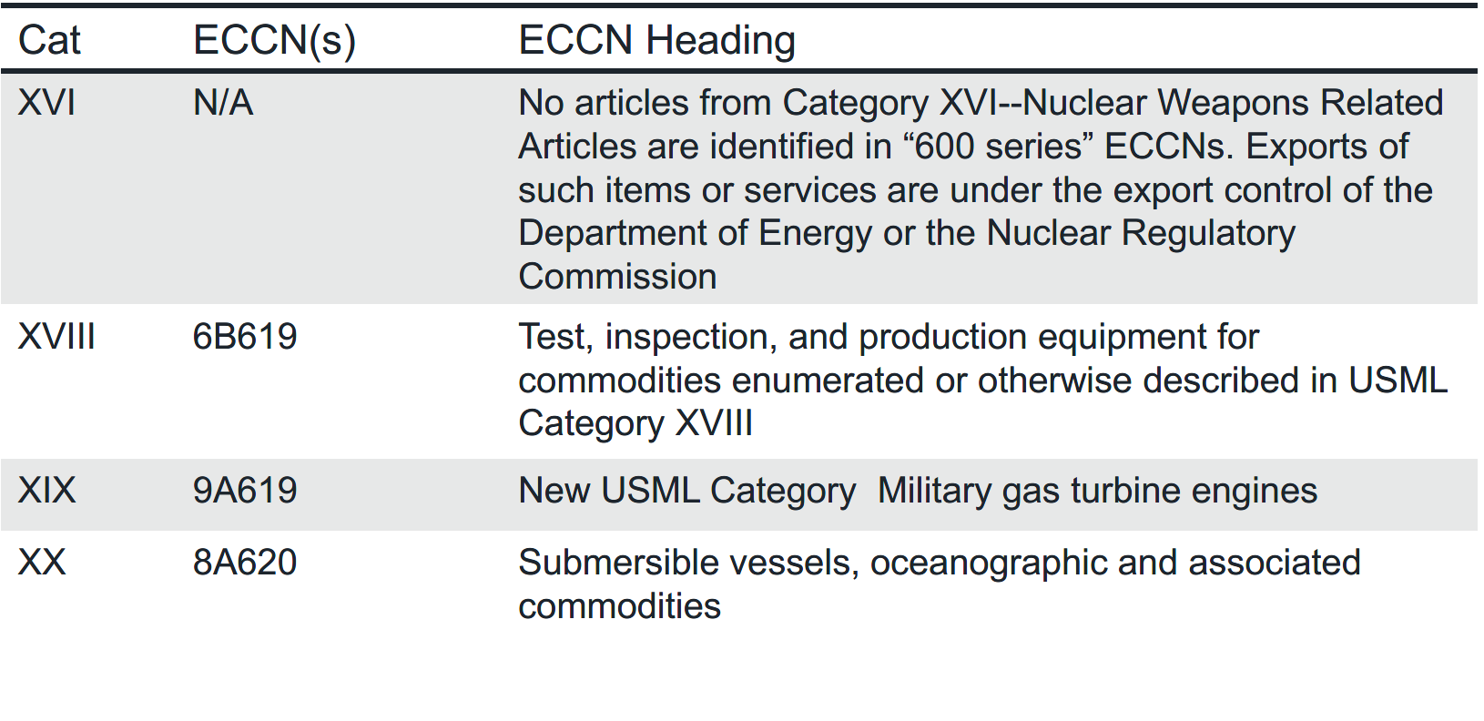
ECR: ITAR EAR

Slide 12
ECR: Why is transition so important?
ITAR and EAR have vastly different licensing requirements.
ITAR require a license, unless exempt.
EAR, in most cases, does not.
ECR extends this to military items that have transitioned from the ITAR U.S. Munitions List to the EAR 600 series Export Control Classification Numbers (ECCN).

Slide 13
ECR

Slide 14
ECR
When thinking about 600 series focus is on Country Group A:5 (close allies) and D:5 (not so much).
A:5 (most of Western Europe, plus Argentina, Australia, Canada Japan and New Zealand)
D:5 are essentially the ITAR Presumed Denial countries

Slide 15
ITAR: Presumed Denial a/k/a License Policy NFW
Presumed denial countries:
  22 now, but number is fluid (ITAR §126.1)
  Currently include China, Cuba, Russia, Venezuela, among others

Slide 16
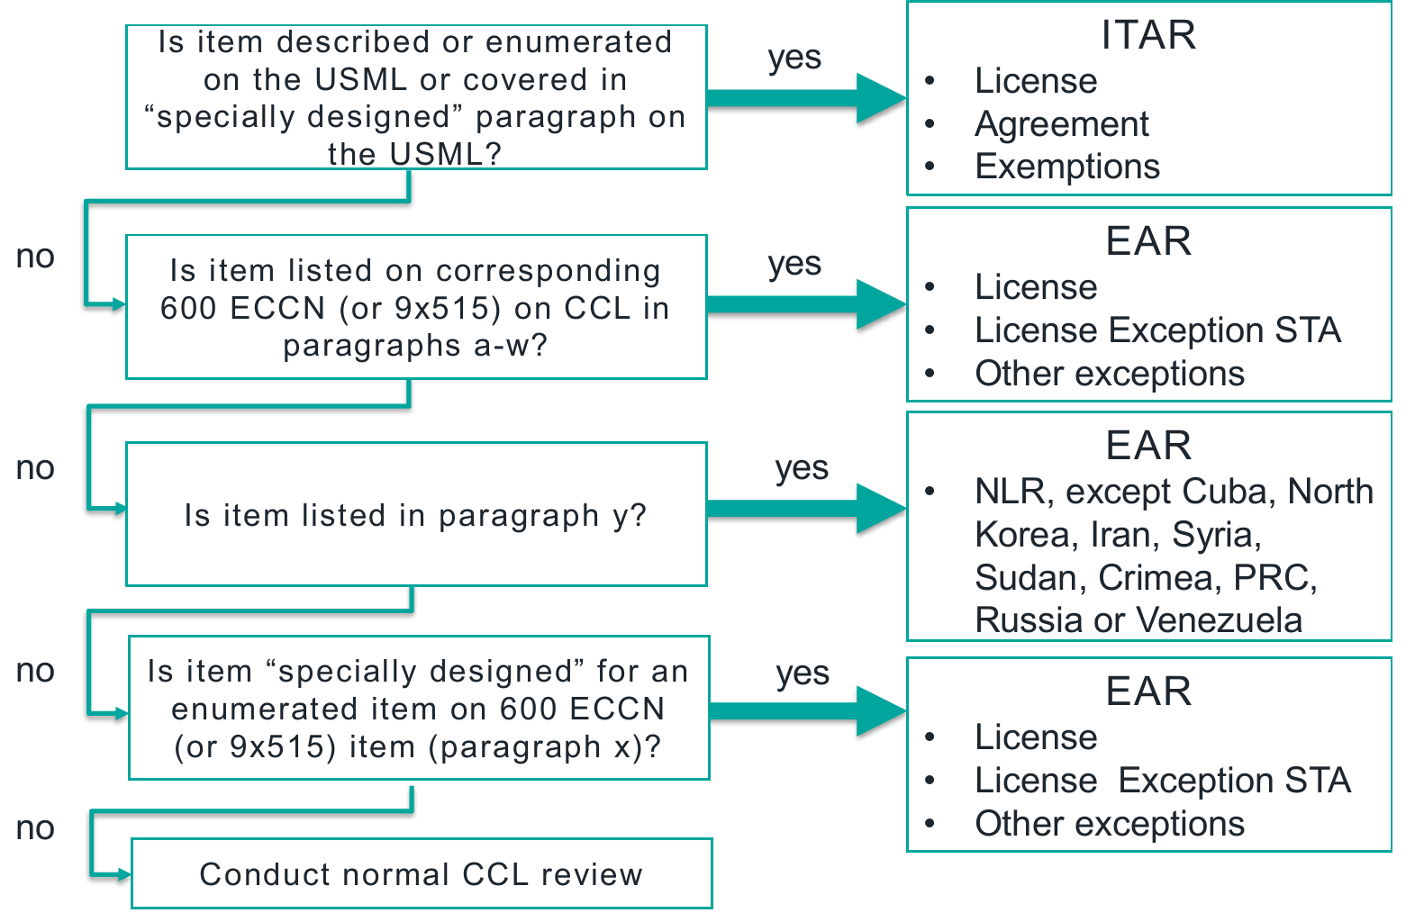
ITAR or EAR? Order of Review

Slide 17
ITAR § 121.1(b)(1) Order of Review
Allows for more than one category on the USML to apply to a defense article, and as such, you should review all potentially relevant USML entries.
In cases where an item is described in multiple entries, an enumerated entry takes precedence over an entry controlling the item by virtue of a specially designed catch-all. The exception to this rule is that a SME entry will take precedence over a non-SME entry.

Slide 18
ITAR §120.41 Specially designed
(1) As a result of development, does the item have properties peculiarly responsible for achieving or exceeding the controlled performance levels, characteristics, or functions described in the relevant U.S. Munitions List paragraph; or
(2) Is a part (see §120.45 (d)), component (see §120.45(b)), accessory (see §120.45(c)), attachment (see §120.45(c)), or software for use in or with a defense article.

Slide 19
ITAR §120.41 Specially designed
Is the item for use in or with defense article? (a)(2) If no, controlled by EAR.
Has the item previously been determined not subject to ITAR by a Commodity Jurisdiction determination? (b)(1) If yes, controlled by EAR.
Is the item a fastener (e.g., screws, bolts, nuts, nut plates, studs, inserts, clips, rivets, pins), washer, spacer, insulator, grommet, bushing, spring, wire, or solder? (b)(2) If yes, controlled by EAR.
Does the item have the same function, performance capabilities, and the same or “equivalent” form and fit as an item that (i) is/was in production and (ii) is not on USML? (b)(3) If yes, controlled by EAR.
Was the item developed (i) as a general purpose item or (ii) for use with both defense articles and non-defense articles? (b)(4, 5) If yes, controlled by EAR.

Slide 20
ITAR – Penalties
Criminal violations of the ITAR may result in fines of up to $1,134,602 , twenty years in jail, or both, per violation for Officers, Directors, and Employees in their individual capacity, and/or debarment from government contracting.
… above penalty amounts apply to EACH VIOLATION

Slide 21

EAR – Penalties
Export violations involving dual-use items, including software and technology are punishable by fines of up to $295,141 , or twice the value of the transaction, whichever is greater.
Aside from the monetary penalty, export violations involving dual-use items also carry the potential of up to twenty years in jail, or both, per violation.
… above penalty amounts apply to EACH VIOLATION

Slide 22
Penalties…
2017-China’s Zhongxing Telecommunications Equipment Corporation and ZTE Kangxun Telecommunications Ltd., (ZTE) incurred a penalty of $1.19 billion for shipping telecommunications equipment to Iran and North Korea in violation of the EAR and the Iranian Transactions and Sanctions Regulations (ITSR)

Slide 23
DDTC's Blue Lantern
End-use monitoring includes pre-license, post-license, and post-shipment checks to verify the bona fides of foreign consignees and end-users, confirm the legitimacy of proposed transactions, and provide reasonable assurance that 1) the recipient is complying with the requirements imposed by the United States Government with respect to use, transfers, and security of defense articles and defense services; and 2) such articles and services are being used for the purposes for which they are provided.

Slide 24
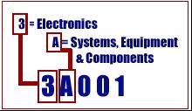
EAR (Commerce Control List)
The Export Control
Classification Number (ECCN)
10 product categories:
0 ‐ Nuclear Materials, Facilities and Equipment and Miscellaneous
1 ‐ Materials, Chemicals, “Microorganisms,” and Toxins
2 – Material Processing
3 – Electronics
4 – Computers
5 ‐ Telecommunications and Information Security
6 – Lasers and Sensors
7 – Navigation and Avionics
8 – Marine
9 – Propulsion Systems, Space Vehicles and Related Equipment

Slide 25
EAR (Commerce Control List)
Each category has the same
5 product groups:
A – “End Items,” “Equipment,”
“Accessories” and “Attachments,” “Parts,”
“Components,” and “Systems”
B ‐ Test, Inspection and “Production Equipment”
C – “Materials”
D – “Software”
E – “Technology”

Slide 26
EAR (Commerce Control List)
Third digit denotes Reasons for Control
assigned in order of precedence, e.g. if item controlled for both National Security and Missile Technology reasons, the ECCN’s third character will be a “0”. If item
is controlled only for Missile Technology the third alphanumeric character will be “1".
0- National Security
1- Missile Technology
2- Nuclear Nonproliferation
3- Chemical and Biological
5- National Security or Foreign Policy
6- Wassenaar Arrangement Munitions List
(WAML) or former US Munitions List
9- Anti‐terrorism, Crime Control, Regional
Stability, Short Supply, UN Sanctions, etc.

Slide 27
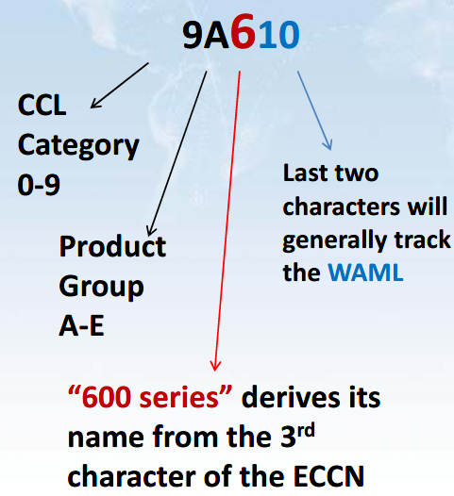
ECCN of a 600 series controlled item

Slide 28
EAR-Controlled Technology & Software
Technology generally available to the public at no charge, or a charge that does not exceed the cost of reproduction and distribution, may be exported to all countries without a License because it is not subject to the EAR
Most Operation Technology may be exported under License Exception TSU to any country (except Iran and likely Sudan).
Most Sales Technology, i.e. data supporting a prospective or actual quotation, bid, or offer to sell, lease, or otherwise supply any item may be exported under License Exception TSU to any country (except Iran and likely Sudan).
Most non-cryptographic software may be exported under NLR or License Exception TSU to all destinations except Embargoed Countries.

Slide 29
EAR-Controlled Technology & Software
All other technology ought to be classified under the applicable ECCN so as to determine whether NLR or License Exceptions TSR, TSU, CIV, or APP may be used for its export to a specific destination.
If no ECCN applies (EAR99) then No License is Required (NLR).
If ECCN states “TSR: Yes”, then it may be exported to Country Group B so long as written assurance provisions from the recipient confirms that the technical data will be reexported to unauthorized destinations.
If ECCN states “CIV-Yes”, then it may be exported to civil end-users for civil end-uses in Country Group D:1, except North Korea.

Slide 30
Examples of License Exceptions
SHIPMENTS TO COUNTRY GROUP B (GBS)
CIVIL END-USERS (CIV)
TECHNOLOGY & SOFTWARE UNDER RESTRICTION (TSR)
  may be exported to all destinations in Country Group B with letter of assurance from customer that software will not be reexported to unauthorized destinations without Commerce Department authorization.
COMPUTERS (APP)
TECHNOLOGY AND SOFTWARE UNRESTRICTED (TSU)
  Most Mass Market Software, Operations Software in object code
ENCRYPTION COMMODITIES, SOFTWARE AND TECH. (ENC)
STRATEGIC TRADE AUTHORIZATION (STA)

Slide 31
OFAC Administered Sanctions
Apply to U.S. persons, companies incorporated in the US, US citizens and permanent residents, and, in certain circumstances, non-U.S. persons.
Three basic categories of sanctions:
  List-based sanctions;
  Comprehensive country- or region-based sanctions; and
  Sector-based sanctions.

Slide 32
OFAC List-Based Sanctions
List-based sanctions prohibit U.S. persons from engaging in virtually all direct or indirect transactions or dealings with persons designated on OFAC’s list of Specially Designated Nationals and Blocked Persons (SDN List) (or companies owned 50 percent or more by such blocked persons).

Slide 33
OFAC Comprehensive Sanctions
Comprehensive sanctions broadly prohibit U.S. persons and, in certain instances, non-U.S. persons, from engaging in business activities with specific countries or regions (e.g., Iran, Syria, Cuba, North Korea and the Crimea region), including importing or exporting, directly or indirectly, goods or services to or from such countries or regions, unless authorized by OFAC.

Slide 34
OFAC Sectoral Sanctions
Sectoral or sector-based sanctions prohibit U.S. persons from engaging in certain specified transactions with certain entities operating in strategic sectors of the Russian economy.

Slide 35
OFAC
OFAC comprehensive sanctions on: Crimea, Cuba, Iran, North Korea, Syria and the sanctions against Sudan were revoked on October 12, 2017.
OFAC maintains targeted sanctions: Balkans, Belarus, Burundi, Central African Republic, Democratic Republic of the Congo, Iraq, Lebanon, Liberia, Libya, Somalia, South Sudan, Ukraine / Russia, Venezuela, Yemen, Zimbabwe
Above are fluid, check in frequently with your Export Control attorney.

Slide 36
DFARS 252.204-7012 – Safeguarding Covered Defense Information and Cyber Incident Reporting (OCT 2016)
The Contractor shall implement NIST SP 800-171, as soon as practical, but not later than December 31, 2017.
For contracts awarded prior to October 1, 2017, the Contractor must notify the DoD CIO, via e-mail at osd.dibcsia@mail.mil within 30 days of contract award, of any security requirements specified by NIST SP 800-171 that are not implemented at the time of contract award.
The contractor shall submit written requests to vary from NIST SP 800-171 and it “need not implement any security requirement adjudicated by an authorized representative of the DoD CIO to be nonapplicable or to have an alternative, but equally effective, security measure that may be implemented in its place.”

Slide 37
DFARS 252.204-7012 – I’m a guy who like to ask why?
Structured to ensure that unclassified DoD information residing on a contractor’s internal information system is safeguarded from cyber incidents, and that any consequences associated with the loss of this information are assessed and minimized via the cyber incident reporting and damage assessment processes.

